Slide 1


Slide 2
Day 1:
Jesus Teaches Us to Be a Friend: The Four Friends

Slide 3
Let’s Get Started
CCLI # 5543557

Slide 4
Let's get started
It's another day.

Slide 5
It's a new beginning.
The past is washed away.

Slide 6
So let's get
started right now!

Slide 7
Let's get started
It's high time
we got started.

Slide 8
The low down
is this
You don't want to miss

Slide 9
What's coming round the bend
What's waiting for you when

Slide 10
You get started,
So let's get
started right now.

Slide 11
Let's get started
No reason to wait

Slide 12
Take your position
You've got a brand new slate.

Slide 13
So let's get
started right now!

Slide 14
Let's get started
It's high time
we got started.

Slide 15
The low down
is this
You don't want
to miss

Slide 16
What's coming round the bend
What's waiting for you when

Slide 17
You get started,
So let's get
started right now.

Slide 18
So kick it
in gear!
Get on
your mark!

Slide 19
Rev up your engines!
We're ready
to start!

Slide 20
The whistle
is blowing!
The flag has dropped low!

Slide 21
The kickoff has happened!
Ready, Set, Go!

Slide 22
Let's get started
It's another day.

Slide 23
It's a new beginning.
The past is washed away.

Slide 24
So let's get
started right now!

Slide 25
Let's get started
It's high time we got started.

Slide 26
The low down is this
You don't want to miss

Slide 27
What's coming round the bend
What's waiting for you when

Slide 28
You get started,
So let's get
started right now.

Slide 29
Let's get
started right now!

Slide 30
Unit Bible Verse Acts 1:8
But you will receive power when the Holy Spirit comes on you; and you will be my witnesses in Jerusalem, and in all Judea and Samaria, and to the ends of the earth.

Slide 31
I’ll Follow You
CCLI # 5543784

Slide 32
Now I resolve
with all my heart,

Slide 33
With all my strength, to serve the Lord;

Slide 34
From His commands,
I won’t depart,

Slide 35
And serving Him
is my reward.

Slide 36
I’ll follow you;
I’ll follow you.

Slide 37
That’s what
I’ll do
I’ll follow you.

Slide 38
With all my heart, with all my mind

Slide 39
With all my strength,
with all I am

Slide 40
I’ll follow you;
I’ll follow you.

Slide 41
This is the purpose
of my soul,

Slide 42
My solemn will,
my final choice,

Slide 43
I’ll give to Him
my life’s control,

Slide 44
And in His kind commands rejoice.

Slide 45
I’ll follow you;
I’ll follow you.

Slide 46
That’s what
I’ll do
I’ll follow you

Slide 47
With all my heart, with all my mind

Slide 48
With all my strength,
with all I am

Slide 49
I’ll follow you;
I’ll follow you.

Slide 50
Oh may I not grow faint or tired,

Slide 51
Or ever leave
Your holy ways;

Slide 52
O Lord my God,
my soul’s desire,

Slide 53
Give me the strength
to live Your praise.

Slide 54
I’ll follow you;
I’ll follow you.

Slide 55
That’s what
I’ll do
I’ll follow you

Slide 56
With all my heart, with all my mind

Slide 57
With all my strength,
with all I am

Slide 58
With all my heart, with all my mind

Slide 59
With all my strength,
with all I am

Slide 60
With all my heart, with all my mind

Slide 61
With all my strength,
with all I am

Slide 62
I’ll follow you;
I’ll follow you.

Slide 63
I’ll follow you
I’ll follow you

Slide 64
I’ll follow you!

Slide 65

Pledge to the American Flag
I pledge allegiance to the flag of the United States of America, and to the Republic for which it stands, one nation under God, indivisible, with liberty and justice for all.

Slide 66

Pledge to the Christian Flag
I pledge allegiance to the Christian flag, and to the Savior for whose kingdom it stands, on brotherhood uniting all Christians in service and love.

Slide 67

Pledge to the Bible
I pledge allegiance to the Bible, God’s holy word, and will make it a lamp unto my feet, a light unto my path, and hide its words in my heart that I may not sin against God.

Slide 68
There Is Someone
CCLI # 5625396

Slide 69
When I feel alone
When I feel afraid

Slide 70
When nothing's gone right
With the plans that I've made

Slide 71
When I feel ignored;
When I'm
feeling sad;

Slide 72
When I've been laughed at
and when I
am mad

Slide 73
Frustrated or elated;
if I'm loved
or I’m hated

Slide 74
There is someone
Who has promised to stay

Slide 75
There’s no emotion
that’ll drive
Him away.

Slide 76
He can handle
all my doubts and fears,

Slide 77
He will take me
in His arms
and wipe away
all my tears.

Slide 78
When I feel confused;
Don't know what to do;

Slide 79
And none of
my dreams
seem like they will come true.

Slide 80
When I'm
feeling lost;
and I don't
want to try

Slide 81
My feelings
are hurt
and I just
want to cry.

Slide 82
My smiles and my frowns;
my ups
and my downs,

Slide 83
There is someone
Who has promised to stay

Slide 84
There’s no emotion
that’ll drive
Him away.

Slide 85
He can handle
all my doubts and fears,

Slide 86
He will take me
in His arms
and wipe away
all my tears.

Slide 87
Frustrated or elated; if I'm loved or I’m hated;

Slide 88
My smiles and my frowns; my ups
and my downs,

Slide 89
Frustrated or elated; if I'm
loved or hated;

Slide 90
My smiles and my frowns;
my ups
and my downs,

Slide 91
Frustrated or
elated; if I'm
loved or hated;

Slide 92
My smiles and my frowns;
my ups
and my downs,

Slide 93
He stays through them all!

Slide 94
There is someone Who has promised
to stay

Slide 95
There’s no emotion
that’ll drive
Him away.

Slide 96
He can handle
all my doubts and fears,

Slide 97
He will take me
in His arms
and wipe away
all my tears.

Slide 98
There is someone Who has promised
to stay

Slide 99
There’s no emotion
that’ll drive
Him away.

Slide 100
He can handle
all my doubts and fears,

Slide 101
He will take me
in His arms
and wipe away
all my tears.

Slide 102
Mission Story: The Parable of the Three Farmers

Slide 103
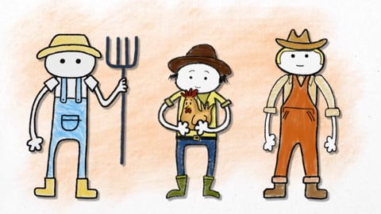

Slide 104
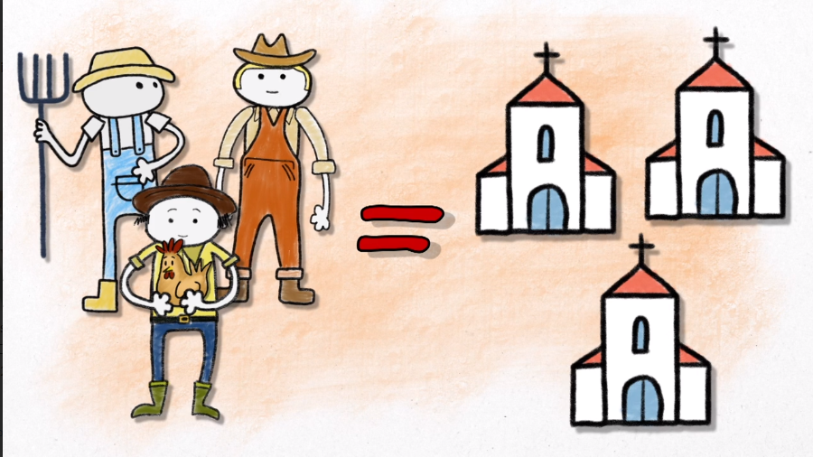

Slide 105
