Slide 1
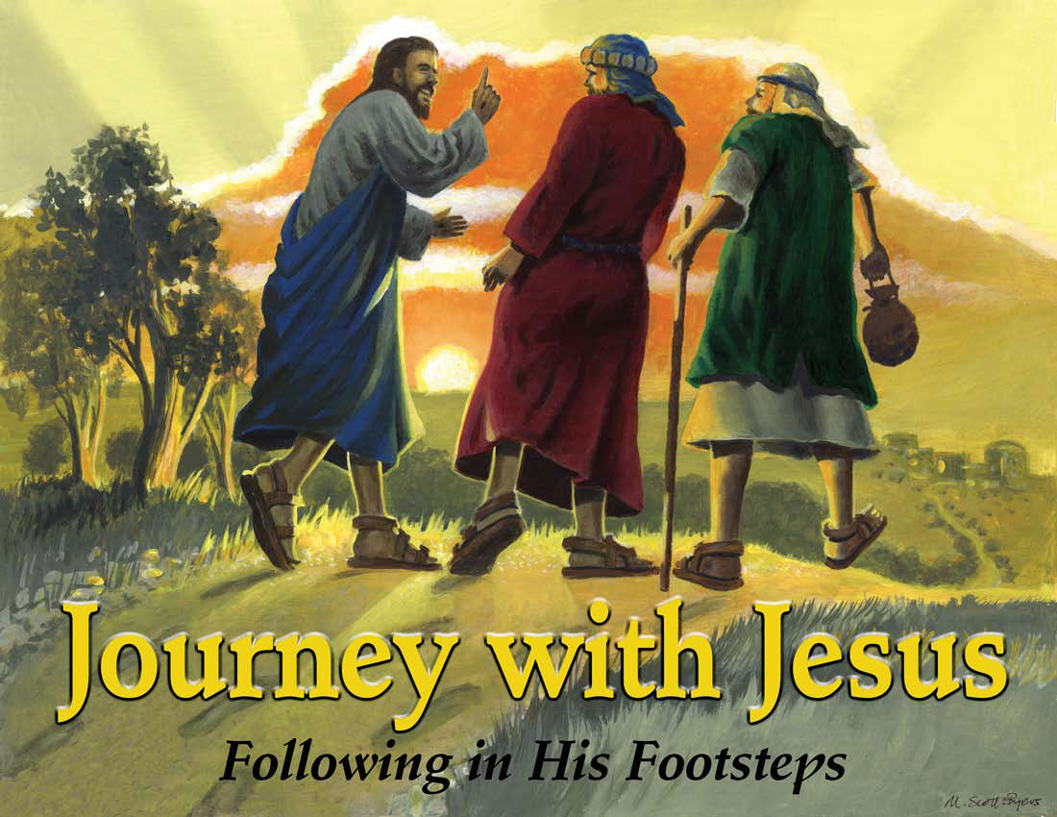

Slide 2
Day 2:
Jesus Teaches Us About Caring for Others: The Good Samaritan

Slide 3
Let’s Get Started
CCLI # 5543557

Slide 4
Let's get started
It's another day.

Slide 5
It's a new beginning.
The past is washed away.

Slide 6
So let's get
started right now!

Slide 7
Let's get started
It's high time
we got started.

Slide 8
The low down
is this
You don't want to miss

Slide 9
What's coming round the bend
What's waiting for you when

Slide 10
You get started,
So let's get
started right now.

Slide 11
Let's get started
No reason to wait

Slide 12
Take your position
You've got a brand new slate.

Slide 13
So let's get
started right now!

Slide 14
Let's get started
It's high time
we got started.

Slide 15
The low down
is this
You don't want
to miss

Slide 16
What's coming round the bend
What's waiting for you when

Slide 17
You get started,
So let's get
started right now.

Slide 18
So kick it
in gear!
Get on
your mark!

Slide 19
Rev up your engines!
We're ready
to start!

Slide 20
The whistle
is blowing!
The flag has dropped low!

Slide 21
The kickoff has happened!
Ready, Set, Go!

Slide 22
Let's get started
It's another day.

Slide 23
It's a new beginning.
The past is washed away.

Slide 24
So let's get
started right now!

Slide 25
Let's get started
It's high time we got started.

Slide 26
The low down is this
You don't want to miss

Slide 27
What's coming round the bend
What's waiting for you when

Slide 28
You get started,
So let's get
started right now.

Slide 29
Let's get
started right now!

Slide 30
Unit Bible Verse Acts 1:8
But you will receive power when the Holy Spirit comes on you; and you will be my witnesses in Jerusalem, and in all Judea and Samaria, and to the ends of the earth.

Slide 31
I’ll Follow You
CCLI # 5543784

Slide 32
Now I resolve
with all my heart,

Slide 33
With all my strength, to serve the Lord;

Slide 34
From His commands,
I won’t depart,

Slide 35
And serving Him
is my reward.

Slide 36
I’ll follow you;
I’ll follow you.

Slide 37
That’s what
I’ll do
I’ll follow you.

Slide 38
With all my heart, with all my mind

Slide 39
With all my strength,
with all I am

Slide 40
I’ll follow you;
I’ll follow you.

Slide 41
This is the purpose
of my soul,

Slide 42
My solemn will,
my final choice,

Slide 43
I’ll give to Him
my life’s control,

Slide 44
And in His kind commands rejoice.

Slide 45
I’ll follow you;
I’ll follow you.

Slide 46
That’s what
I’ll do
I’ll follow you

Slide 47
With all my heart, with all my mind

Slide 48
With all my strength,
with all I am

Slide 49
I’ll follow you;
I’ll follow you.

Slide 50
Oh may I not grow faint or tired,

Slide 51
Or ever leave
Your holy ways;

Slide 52
O Lord my God,
my soul’s desire,

Slide 53
Give me the strength
to live Your praise.

Slide 54
I’ll follow you;
I’ll follow you.

Slide 55
That’s what
I’ll do
I’ll follow you

Slide 56
With all my heart, with all my mind

Slide 57
With all my strength,
with all I am

Slide 58
With all my heart, with all my mind

Slide 59
With all my strength,
with all I am

Slide 60
With all my heart, with all my mind

Slide 61
With all my strength,
with all I am

Slide 62
I’ll follow you;
I’ll follow you.

Slide 63
I’ll follow you
I’ll follow you

Slide 64
I’ll follow you!

Slide 65

Pledge to the American Flag
I pledge allegiance to the flag of the United States of America, and to the Republic for which it stands, one nation under God, indivisible, with liberty and justice for all.

Slide 66
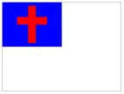
Pledge to the Christian Flag
I pledge allegiance to the Christian flag, and to the Savior for whose kingdom it stands, on brotherhood uniting all Christians in service and love.

Slide 67

Pledge to the Bible
I pledge allegiance to the Bible, God’s holy word, and will make it a lamp unto my feet, a light unto my path, and hide its words in my heart that I may not sin against God.

Slide 68
Without You, Jesus
CCLI # 5536375

Slide 69
Without you, Jesus,
I'm only half
as cool.

Slide 70
Without you, Jesus,
I'm a ring
without the jewel.

Slide 71
Without you, Jesus,
My engine's
out of fuel.

Slide 72
You always have my back.
There's so much that I would lack without you!

Slide 73
Without you, Jesus,
I don't feel
I belong.

Slide 74
Without you, Jesus,
I’ve got no rhythm in
my song.

Slide 75
Without you, Jesus,
I don't know right from wrong.

Slide 76
All I feel is stressed,
And I'll never
be my best
without you!

Slide 77
Jesus

Slide 78
You're the smile upon my face

Slide 79
Jesus

Slide 80
You're the
one who took
my place

Slide 81
Jesus

Slide 82
You're what's amazing about grace!

Slide 83
Through this crazy life that's full of doubt,

Slide 84
I never ever
never wanna be
without You!

Slide 85
Without you, Jesus,
My get up just won't go.

Slide 86
Without you, Jesus,
My candle has
no glow.

Slide 87
Without you, Jesus,
My high five's low, low, low.

Slide 88
I'm a bike
without its wheels,
I’m a day
without three meals
without you.

Slide 89
Jesus

Slide 90
You're the smile upon my face

Slide 91
Jesus

Slide 92
You're the
one who took
my place,

Slide 93
Jesus

Slide 94
You're what's amazing about grace!

Slide 95
Through this crazy life that's full of doubt,

Slide 96
I never ever
never wanna be
without…

Slide 97
Jesus

Slide 98
You're the smile upon my face

Slide 99
Jesus

Slide 100
You're the
one who took
my place,

Slide 101
Jesus

Slide 102
You're what's amazing about grace!

Slide 103
Through this crazy life that's full of doubt,

Slide 104
I never ever
never wanna be
without You!

Slide 105
Mission Story: Church Starting: Tradewind Community Church, Amarillo, TX

Slide 106
