Slide 1
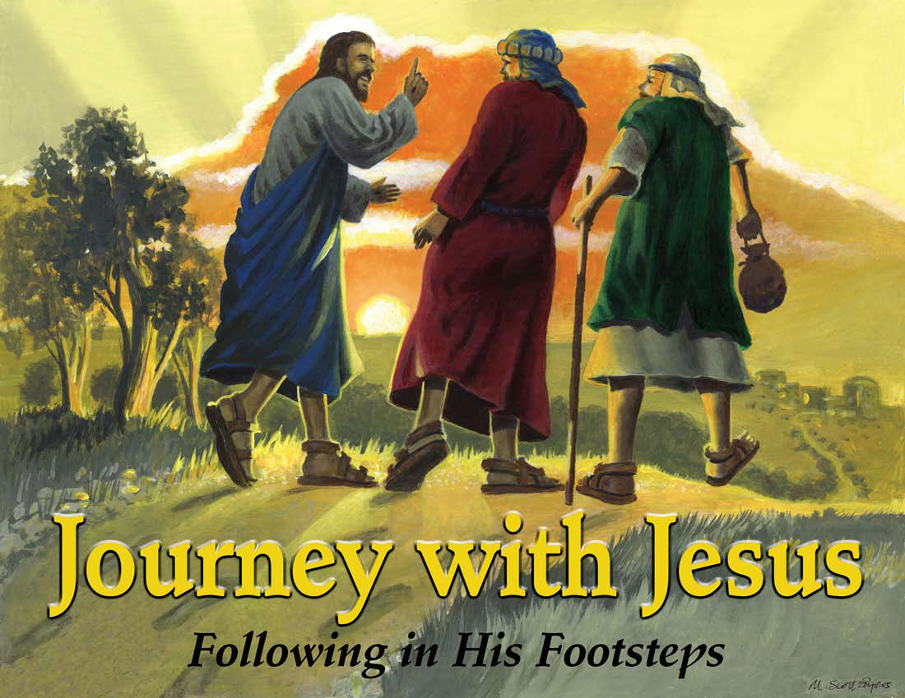

Slide 2
Day 3:
Jesus Teaches Us About Loving Others: Zacchaeus

Slide 3
Let’s Get Started
CCLI # 5543557

Slide 4
Let's get started
It's another day.

Slide 5
It's a new beginning.
The past is washed away.

Slide 6
So let's get
started right now!

Slide 7
Let's get started
It's high time
we got started.

Slide 8
The low down
is this
You don't want to miss

Slide 9
What's coming round the bend
What's waiting for you when

Slide 10
You get started,
So let's get
started right now.

Slide 11
Let's get started
No reason to wait

Slide 12
Take your position
You've got a brand new slate.

Slide 13
So let's get
started right now!

Slide 14
Let's get started
It's high time
we got started.

Slide 15
The low down
is this
You don't want
to miss

Slide 16
What's coming round the bend
What's waiting for you when

Slide 17
You get started,
So let's get
started right now.

Slide 18
So kick it
in gear!
Get on
your mark!

Slide 19
Rev up your engines!
We're ready
to start!

Slide 20
The whistle
is blowing!
The flag has dropped low!

Slide 21
The kickoff has happened!
Ready, Set, Go!

Slide 22
Let's get started
It's another day.

Slide 23
It's a new beginning.
The past is washed away.

Slide 24
So let's get
started right now!

Slide 25
Let's get started
It's high time we got started.

Slide 26
The low down is this
You don't want to miss

Slide 27
What's coming round the bend
What's waiting for you when

Slide 28
You get started,
So let's get
started right now.

Slide 29
Let's get
started right now!

Slide 30
Unit Bible Verse Acts 1:8
But you will receive power when the Holy Spirit comes on you; and you will be my witnesses in Jerusalem, and in all Judea and Samaria, and to the ends of the earth.

Slide 31
I’ll Follow You
CCLI # 5543784

Slide 32
Now I resolve
with all my heart,

Slide 33
With all my strength, to serve the Lord;

Slide 34
From His commands,
I won’t depart,

Slide 35
And serving Him
is my reward.

Slide 36
I’ll follow you;
I’ll follow you.

Slide 37
That’s what
I’ll do
I’ll follow you.

Slide 38
With all my heart, with all my mind

Slide 39
With all my strength,
with all I am

Slide 40
I’ll follow you;
I’ll follow you.

Slide 41
This is the purpose
of my soul,

Slide 42
My solemn will,
my final choice,

Slide 43
I’ll give to Him
my life’s control,

Slide 44
And in His kind commands rejoice.

Slide 45
I’ll follow you;
I’ll follow you.

Slide 46
That’s what
I’ll do
I’ll follow you

Slide 47
With all my heart, with all my mind

Slide 48
With all my strength,
with all I am

Slide 49
I’ll follow you;
I’ll follow you.

Slide 50
Oh may I not grow faint or tired,

Slide 51
Or ever leave
Your holy ways;

Slide 52
O Lord my God,
my soul’s desire,

Slide 53
Give me the strength
to live Your praise.

Slide 54
I’ll follow you;
I’ll follow you.

Slide 55
That’s what
I’ll do
I’ll follow you

Slide 56
With all my heart, with all my mind

Slide 57
With all my strength,
with all I am

Slide 58
With all my heart, with all my mind

Slide 59
With all my strength,
with all I am

Slide 60
With all my heart, with all my mind

Slide 61
With all my strength,
with all I am

Slide 62
I’ll follow you;
I’ll follow you.

Slide 63
I’ll follow you
I’ll follow you

Slide 64
I’ll follow you!

Slide 65

Pledge to the American Flag
I pledge allegiance to the flag of the United States of America, and to the Republic for which it stands, one nation under God, indivisible, with liberty and justice for all.

Slide 66
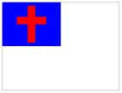
Pledge to the Christian Flag
I pledge allegiance to the Christian flag, and to the Savior for whose kingdom it stands, on brotherhood uniting all Christians in service and love.

Slide 67

Pledge to the Bible
I pledge allegiance to the Bible, God’s holy word, and will make it a lamp unto my feet, a light unto my path, and hide its words in my heart that I may not sin against God.

Slide 68
It All Comes Down To Love
CCLI # 5543832

Slide 69
Faith is fine,
but you gotta
have love.

Slide 70
Hope can help,
but you gotta
have love.

Slide 71
Pray for patience, but you still
need love.

Slide 72
It all comes
down to love.

Slide 73
Grace is great,
but you gotta
have love.

Slide 74
Caring's cool,
but you gotta
have love.

Slide 75
Peace is priceless, but you still
need love.

Slide 76
It all comes
down to love.

Slide 77
This is how
they'll know it
Because we're gonna show it

Slide 78
You gotta, gotta, gotta, gotta, have love!

Slide 79
The greatest of these is love
The greatest of these is love

Slide 80
The greatest of these is love
It all comes down to love.

Slide 81
The greatest of these is love
The greatest of these is love

Slide 82
The greatest of these is love
It all comes
down to love.

Slide 83
Faith is fine,
but you gotta
have love.

Slide 84
Hope can help,
but you gotta
have love.

Slide 85
Pray for patience, but you still
need love.

Slide 86
It all comes
down to love.

Slide 87
Grace is great,
but you gotta
have love.

Slide 88
Caring's cool,
but you gotta
have love.

Slide 89
Peace is priceless, but you still
need love.

Slide 90
It all comes
down to love.

Slide 91
This is how
they'll know it
Because we're gonna show it

Slide 92
You gotta, gotta, gotta, gotta, have love!

Slide 93
The greatest of these is love
The greatest of these is love

Slide 94
The greatest of these is love
It all comes down to love.

Slide 95
The greatest of these is love
The greatest of these is love

Slide 96
The greatest of these is love
It all comes
down to love.

Slide 97
Love, love,
love, love
Love, love,
love, love

Slide 98
Love, love,
love, love
It all comes
down to love

Slide 99
Love, love,
love, love
Love, love,
love, love

Slide 100
Love, love,
love, love
It all comes
down to love

Slide 101
This is how
they'll know it
Because we're gonna show it!

Slide 102
You gotta, gotta, gotta, gotta, have love!

Slide 103
The greatest of these is love
The greatest of these is love

Slide 104
The greatest of these is love
It all comes down to love.

Slide 105
The greatest of these is love
The greatest of these is love

Slide 106
The greatest of these is love
It all comes
down to love.

Slide 107
This is how
they'll know it
Because we're gonna show it

Slide 108
You gotta, gotta, gotta, gotta, have love!

Slide 109
It all comes
down to love!

Slide 110
Mission Story: STCH Ministries, Corpus Christi, TX

Slide 111


