Slide 1
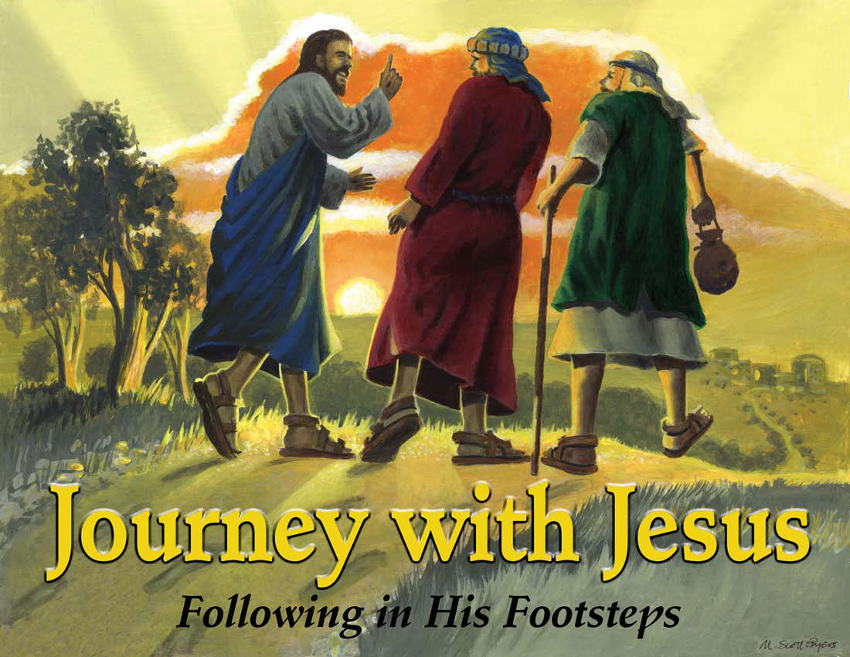

Slide 2
Day 4:
Jesus Loves Us : The Resurrection

Slide 3
Let’s Get Started
CCLI # 5543557

Slide 4
Let's get started
It's another day.

Slide 5
It's a new beginning.
The past is washed away.

Slide 6
So let's get
started right now!

Slide 7
Let's get started
It's high time
we got started.

Slide 8
The low down
is this
You don't want to miss

Slide 9
What's coming round the bend
What's waiting for you when

Slide 10
You get started,
So let's get
started right now.

Slide 11
Let's get started
No reason to wait

Slide 12
Take your position
You've got a brand new slate.

Slide 13
So let's get
started right now!

Slide 14
Let's get started
It's high time
we got started.

Slide 15
The low down
is this
You don't want
to miss

Slide 16
What's coming round the bend
What's waiting for you when

Slide 17
You get started,
So let's get
started right now.

Slide 18
So kick it
in gear!
Get on
your mark!

Slide 19
Rev up your engines!
We're ready
to start!

Slide 20
The whistle
is blowing!
The flag has dropped low!

Slide 21
The kickoff has happened!
Ready, Set, Go!

Slide 22
Let's get started
It's another day.

Slide 23
It's a new beginning.
The past is washed away.

Slide 24
So let's get
started right now!

Slide 25
Let's get started
It's high time we got started.

Slide 26
The low down is this
You don't want to miss

Slide 27
What's coming round the bend
What's waiting for you when

Slide 28
You get started,
So let's get
started right now.

Slide 29
Let's get
started right now!

Slide 30
Unit Bible Verse
Acts 1:8
But you will receive power when the Holy Spirit comes on you; and you will be my witnesses in Jerusalem, and in all Judea and Samaria, and to the ends of the earth.

Slide 31
I’ll Follow You
CCLI # 5543784

Slide 32
Now I resolve
with all my heart,

Slide 33
With all my strength, to serve the Lord;

Slide 34
From His commands,
I won’t depart,

Slide 35
And serving Him
is my reward.

Slide 36
I’ll follow you;
I’ll follow you.

Slide 37
That’s what
I’ll do
I’ll follow you.

Slide 38
With all my heart, with all my mind

Slide 39
With all my strength,
with all I am

Slide 40
I’ll follow you;
I’ll follow you.

Slide 41
This is the purpose
of my soul,

Slide 42
My solemn will,
my final choice,

Slide 43
I’ll give to Him
my life’s control,

Slide 44
And in His kind commands rejoice.

Slide 45
I’ll follow you;
I’ll follow you.

Slide 46
That’s what
I’ll do
I’ll follow you

Slide 47
With all my heart, with all my mind

Slide 48
With all my strength,
with all I am

Slide 49
I’ll follow you;
I’ll follow you.

Slide 50
Oh may I not grow faint or tired,

Slide 51
Or ever leave
Your holy ways;

Slide 52
O Lord my God,
my soul’s desire,

Slide 53
Give me the strength
to live Your praise.

Slide 54
I’ll follow you;
I’ll follow you.

Slide 55
That’s what
I’ll do
I’ll follow you

Slide 56
With all my heart, with all my mind

Slide 57
With all my strength,
with all I am

Slide 58
With all my heart, with all my mind

Slide 59
With all my strength,
with all I am

Slide 60
With all my heart, with all my mind

Slide 61
With all my strength,
with all I am

Slide 62
I’ll follow you;
I’ll follow you.

Slide 63
I’ll follow you
I’ll follow you

Slide 64
I’ll follow you!

Slide 65

Pledge to the American Flag
I pledge allegiance to the flag of the United States of America, and to the Republic for which it stands, one nation under God, indivisible, with liberty and justice for all.

Slide 66

Pledge to the Christian Flag
I pledge allegiance to the Christian flag, and to the Savior for whose kingdom it stands, on brotherhood uniting all Christians in service and love.

Slide 67

Pledge to the Bible
I pledge allegiance to the Bible, God’s holy word, and will make it a lamp unto my feet, a light unto my path, and hide its words in my heart that I may not sin against God.

Slide 68
A Brand New Me
CCLI # 5536296

Slide 69
I’ve got a
new start.
I found a
new way.

Slide 70
I’m a new creature
And it’s a
new day.

Slide 71
That’s who
I was,
That’s not
who I am.

Slide 72
That was
my past,
Thanks to
the Lamb.

Slide 73
I’m a brand
new me!
Oh yeah.

Slide 74
I’m a brand
new me!
Oh yeah.

Slide 75
Whatever I do,
Whatever I say.

Slide 76
I want you to see
What you’re doing in me

Slide 77
And when you watch me work,

Slide 78
And when you watch me play,
I want you to see

Slide 79
I’m a brand
new me!
Oh yeah.

Slide 80
I’m a brand
new me!
Oh yeah.

Slide 81
I’m changing
my ways,
I’m breaking
new ground.

Slide 82
I was so lost,
But now I am found.

Slide 83
I’ve made mistakes,
And still
might fall.

Slide 84
God’s grace
is enough
To cover it all.

Slide 85
I’m a brand
new me!
Oh yeah.

Slide 86
I’m a brand
new me!
Oh yeah.

Slide 87
Whatever I do,
Whatever I say.

Slide 88
I want you to see
What you’re doing in me

Slide 89
And when you watch me work,

Slide 90
And when you watch me play,
I want you to see

Slide 91
I’m a brand
new me!
Oh yeah.

Slide 92
I’m a brand
new me!
Oh yeah.

Slide 93
If any one is
in Christ,
He is a
new creation

Slide 94
What is old has passed away,
look, what is new has come!

Slide 95
I’m not looking back.
I’m pressing ahead.

Slide 96
I’m getting
in line,
with God’s Word instead.

Slide 97
I’m not
giving up,
I’m not
giving in,

Slide 98
In Jesus’ power
I’ve changed from what I’ve been.

Slide 99
Whatever I do,
Whatever I say.

Slide 100
I want you to see
What you’re doing in me

Slide 101
And when you watch me work,

Slide 102
And when you watch me play,

Slide 103
I want you to see

Slide 104
Whatever I do,
Whatever I say.

Slide 105
I want you to see
What you’re doing in me

Slide 106
And when you watch me work,

Slide 107
And when you watch me play,
I want you to see

Slide 108
I’m a brand
new me!
Oh yeah.

Slide 109
I’m a brand
new me!
Oh yeah.

Slide 110
I’m a brand
new me!

Slide 111
Mission Story:
Children at Heart Ministries, Round Rock, TX

Slide 112
